Slide 1

EXCEL MACRO MIGRATION FACTORY
Transforming Legacy Systems for Modern Infrastructure

Slide 2






THE CHALLENGE: Legacy Excel Macros
Legacy Excel macros often present a formidable challenge, hindering digital transformation and introducing significant operational risks. These systems, while once efficient, now frequently lead to critical issues that impact business continuity and growth.
Visible Problems
Data Errors & Performance
Security Vulnerabilities
Integration Complexities
High Maintenance Costs
Addressing these deep-seated issues is crucial for maintaining data integrity, improving operational efficiency, and ensuring a secure and scalable infrastructure for the future.

Slide 3
THE CHALLENGE: Legacy Excel Macros
Data Integrity Risks
Security Vulnerabilities
Scalability Barriers
Outdated business logic embedded in aging code.
Unmanaged macros expose sensitive data to threats.
Manual processes limit growth potential and efficiency.
Knowledge Gaps
Infrastructure Incompatibility
Undocumented legacy code creates dependency risks.
64-bit Nova migration breaks existing 32-bit macros.

Slide 4
OUR SOLUTION: Factory Model Approach
We leverage a scalable, industrialised 'Factory Model' to streamline the migration of legacy Excel macros. This systematic approach ensures efficiency, reliability, and consistency across all projects, significantly reducing risks and accelerating your digital transformation journey.
This structured methodology allows us to deliver high-quality, modernised solutions, ensuring your critical business logic is preserved and future-proofed.

Slide 5
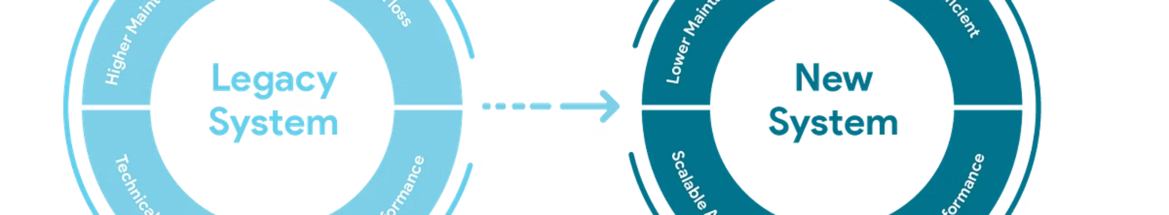


OUR SOLUTION: Factory Model Approach
Compatibility Migration
Digital Transformation
Refactor existing macros for 64-bit Nova architecture, ensuring seamless operation in modern environments.
Rebuild solutions on the SG MAXX platform, enabling advanced functionalities and enhanced efficiency.
Powered by managed services vendor partnerships for scalable delivery.

Slide 6

CORE TECHNICAL CAPABILITIES
Modernisation Expertise
Automation & Integration
MS Excel & Access expertise
Python automation development
VBA code modernisation
SQL database integration
SG MAXX Lambda deployment

Slide 7





BUSINESS VALUE DELIVERED
Operational Efficiency
Enhanced Security
Quality Assurance
Automated workflows reduce manual effort by 60%.
Centralised code management eliminates shadow IT risks.
Standardised testing protocols ensure reliability.
Business Continuity
Risk Mitigation
Future-proof solutions support organisational growth.
Documented processes eliminate single points of failure.

Slide 8

IMPACT: Enabling seamless digital transformation while preserving critical business logic.

